Slide 2
Antra SEP Program
Hello World
Core Java Training 1

Slide 3

Day 1 Training Schedule
Introduction to java
Programming environment
Java programming basics
Getting input from the key board
Control structures

Slide 4
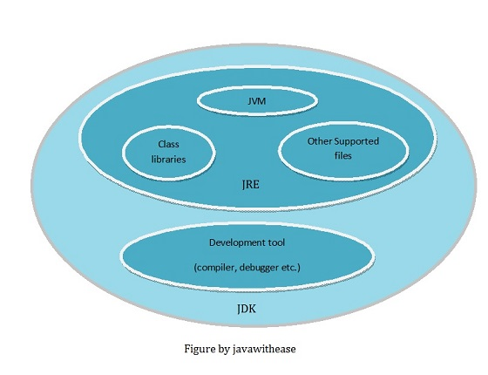
Java Versions
JDK 1.0 (1996)
JDK 1.1 (1997)
JDK 1.2 (1998)
JDK 1.3 (2000)
JDK 1.4 (2002)
JDK 1.5 (2004)
JDK 1.6 (2006)
JDK 1.7 (2011)
JDK 1.8 (2014)

Slide 5
Java Programming Basics
Install the latest version of java.
Set the path and class path in environment variables.
Write code in any editor or IDE.
Compile (javac)
Run (java)
Compiler
HelloWorld.java
HelloWorld.class
JVM
“Hello World”

Slide 6
Statement
A statement represents an action or a sequence of actions.
Format is important.
Make sure the code is clean.
Alignment/Indent/Naming Convention.
//This program prints Welcome to Java!
public class Welcome {
public static void main(String[] args) {
System.out.println("Welcome to Java!");
}
}

Slide 7
Language Fundamentals
Identifiers
Reserved words
Variables
Data types
Operators
Literals
Java coding standards
...

Slide 8
Identifier
A name in the program is an identifier it may be class name or method name, variable name or label name.
A java identifier is a sequence of characters, where each character may be a letter from a-z or A-Z or a digit form 0-9 or “$” or “_”, if we are using any other symbol we will get Compile time error “Illegal Character”.
Identifier should not be starts with digit.
Java Identifiers are case sensitive

Slide 9
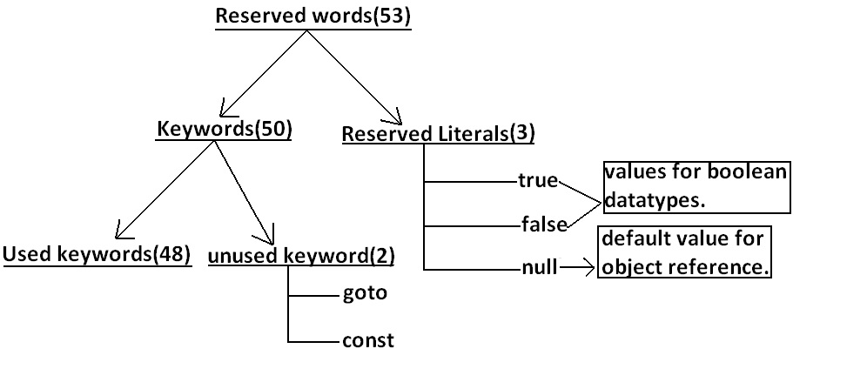
Reserved words
Reserved words or keywords are words that have a specific meaning to the compiler and cannot be used for other purposes in the program. For example, when the compiler sees the word class, it understands that the word after class is the name for the class.
Reserved words for data types:
byte,short,int,long,float,double,char,boolean
Reserved words for flow control:
if ,else,switch ,case ,default ,for ,do ,while ,break ,continue,return
Keywords for modifiers:
public ,private ,protected,static,final ,abstract ,synchronized ,native ,strictfp(1.2 version) ,transient,volatile
keywords for exception handling:
try,catch,finally ,throw,throws,assert(1.4 version)
Class related keywords:
class,package,import,extends,implement,s,interface
Object related keywords:
new,instanceof ,super ,this,

Slide 10
Data Types
Two types
Primitive type
User defined data types -- reference type

Slide 11
Variables
Variable holds the value.
Ex: int x;
Types of variables
Public
Private
Protected
Default

Slide 12
Operator
Operator is symbol that can perform some operation between the operands is called operator
Ex: in c=a+b;
increment & decrement operators. ++ --
arithmetic operators. +-/*%
string concatenation operators. +
Relational operators > < = >= <= ==
Equality operators == !=
Bitwise operators & | ^
Short circuit operators && ||
instance of operators
type cast operators
assignment operator
conditional operator (expression)?1:0
new operator

Slide 13
Literal
A literal represents a constant value which can be assigned to the variables.

Slide 14
Java Coding Standards
Coding standards for classes
Coding standards for interface
Coding standards for method
Coding standards for variable
Coding standards for constants

Slide 15
Naming Conventions
Choose meaningful and descriptive names.
Variables and method names:
Use lowercase. If the name consists of several words, concatenate all in one, use lowercase for the first word, and capitalize the first letter of each subsequent word in the name. For example, the variables radius and area, and the method computeArea.
public class Circle{
int radius;
double area;
String nameOfThisCirle;
public Double computeArea(){
return null;
}
}

Slide 16
Appropriate Comments
Include a summary at the beginning of the program to explain what the program does, its key features, its supporting data structures, and any unique techniques it uses.
Include your name, class section, instructor, date, and a brief description at the beginning of the program.
// single line
/* block */
/**
Documentation
*/

Slide 17
Programming Errors
Syntax Errors
Detected by the compiler
Runtime Errors
Causes the program to abort
Logic Errors
Produces incorrect result

Slide 18
Programming Errors
public class SyntaxErrors {
public static main(String[] args) {
System.out.println("Welcome to Java);
}
}
public class RuntimeErrors {
public static void main(String[] args) {
System.out.println(1 / 0);
}
}
public class LogicErrors {
public static void main(String[] args) {
System.out.println("Celsius 35 is Fahrenheit degree ");
System.out.println((9 / 5) * 35 + 32);
}
}

Slide 19
Named Constants
final static datatype CONSTANTNAME = VALUE;
final static double PI = 3.14159;
final static int SIZE = 3;

Slide 20
Numerical Data Types

Slide 21
Type Casting
Implicit casting
double d = 3; (type widening)
Explicit casting
int i = (int)3.0; (type narrowing)
int i = (int)3.9; (Fraction part is truncated)
What is wrong? int x = 5 / 2.0;

Slide 22
Control Structures
Flow control describes the order in which all the statements will execute at run time.
Flow controls are categorized into 3 types those are
1) Selection statements if - else switch
2) Iterative statements while() do-while for foreach
3) Transfer statements break, continue, return, try-catch-finally

Slide 23
String Type
The char type only represents one character. To represent a string of characters, use the data type called String.
For example, String message = "Welcome to Java";
The String type is NOT a primitive type. It is known as a reference type. Any Java class can be used as a reference type for a variable.

Slide 24
String Concatenation
// Three strings are concatenated
String message = "Welcome " + "to " + "Java";
// String Chapter is concatenated with number 2
String s = "Chapter" + 2; // s becomes Chapter2
// String Supplement is concatenated with character B
String s1 = "Supplement" + 'B'; // s1 becomes SupplementB

Slide 25
Converting Strings to Integers/Numbers
The input returned from the input dialog box is a string. If you enter a numeric value such as 123, it returns “123”. To obtain the input as a number, you have to convert a string into a number.
To convert a string into an int value, you can use the static parseInt method in the Integer class as follows:
int intValue = Integer.parseInt(intString); where intString is a numeric string such as “123”.
Same thing:
double doubleValue =Double.parseDouble(doubleString);
where doubleString is a numeric string such as “123.45”.

Slide 26
Overloading Methods
The method signature is the name and parameter list only.
Methods within a class can have the same name if they have different parameter lists
public static int max(int num1, int num2) {
if (num1 > num2)
return num1;
else
return num2;
}
public static double max(double num1, double num2) {
if (num1 > num2)
return num1;
else
return num2;
}

Slide 27
Scope of Variables
A local variable: a variable defined inside a method.
Scope: the part of the program where the variable can be referenced.
The scope of a local variable starts from its declaration and continues to the end of the block that contains the variable. A local variable must be declared before it can be used.
A instance variable: a variable defined inside a class.
The scope of a instance: variable visible for all methods, constructors and block in the class.
Class/static variable:Class variables also known as static variables are declared with the static keyword in a class, but outside a method, constructor or a block.
The scope of class variable: just one copy of each class variable per class.

Slide 28
How to get the input from the key board
There are many ways to read data from the keyboard. For example:
Scanner Scanner scanner= new Scanner(System.in);

Slide 29
Thanks!

